Slide 1
Ten Usability Heuristics by Jakob Nielsen

Slide 2
Introduction
Usability heuristics are general principles or best practices used in user interface (UI) and user experience (UX) design to ensure that a system is easy to use, efficient, and user-friendly.
These heuristics help designers evaluate and improve the usability of interfaces.
One of the most well-known sets of usability heuristics is Jakob Nielsen's 10 Usability Heuristics for User Interface Design

Slide 3
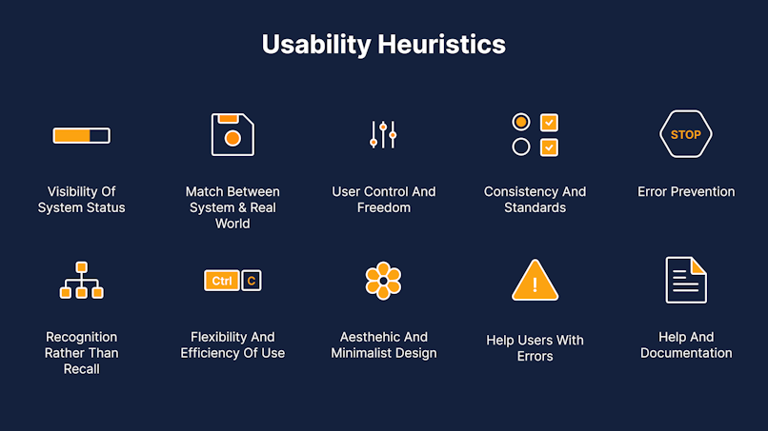

Slide 4
Jakob Nielsen's 10 Usability Heuristics
1: Visibility of System Status
2: Match Between the System and the Real World
3: User Control and Freedom
4: Consistency and Standards
5: Error Prevention
6: Recognition Rather than Recall
7: Flexibility and Efficiency of Use
8: Aesthetic and Minimalist Design
9: Help Users Recognize, Diagnose, and Recover from Errors
10: Help and Documentation

Slide 5
Visibility of System Status
The design should always keep users informed about what is going on, through appropriate feedback within a reasonable amount of time.
When users know the current system status, they learn the outcome of their prior interactions and determine next steps.
Predictable interactions create trust in the product as well as the brand.

Slide 6
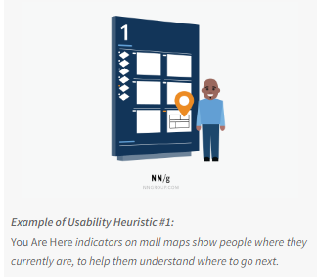
Visibility of System Status
Communicate clearly to users what the system’s state is — no action with consequences to users should be taken without informing them.
Present feedback to the user as quickly as possible (ideally, immediately).
Build trust through open and continuous communication.

Slide 7
Match between system and the real world
The system should speak the users' language, with words, phrases and concepts familiar to the user, rather than system-oriented terms.
Follow real-world conventions, making information appear in a natural and logical order
The way you should design depends very much on your specific users.
Terms, concepts, icons, and images that seem perfectly clear to you and your colleagues may be unfamiliar or confusing to your users.

Slide 8
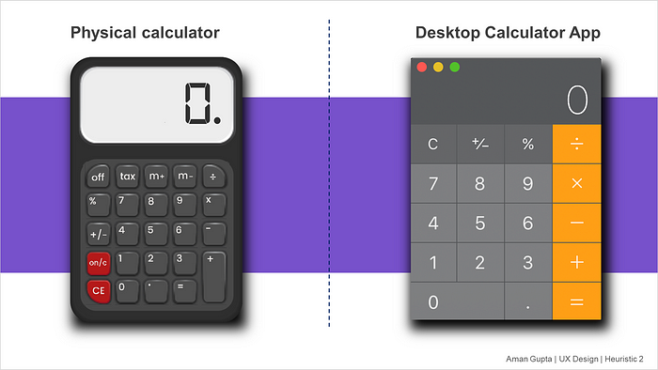
Match between system and the real world
Ensure that users can understand meaning without having to go look up a word’s definition.
Never assume your understanding of words or concepts will match that of your users.
User research will uncover your users' familiar terminology, as well as their mental models around important concepts.

Slide 9
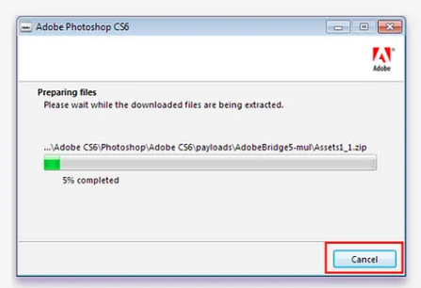
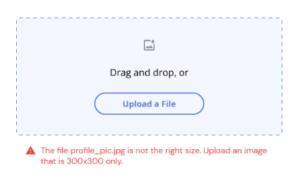
User control and freedom
Users often choose system functions by mistake and will need a clearly marked "emergency exit" to leave the unwanted state without having to go through an extended dialogue.
Support undo and redo.

Slide 10
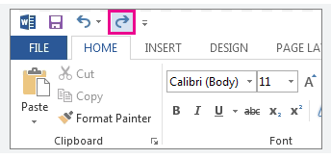
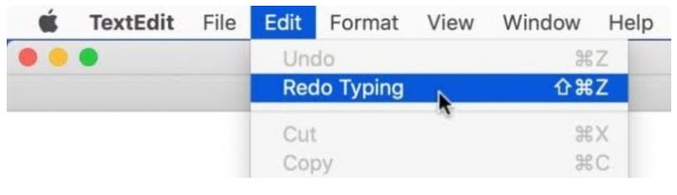
User control and freedom
Support Undo and Redo.
Show a clear way to exit the current interaction, like a Cancel button.
Make sure the exit is clearly labeled and discoverable.

Slide 11
Consistency and standard
Users should not have to wonder whether different words, situations, or actions mean the same thing. Follow platform conventions.
Failing to maintain consistency may increase the users' cognitive load by forcing them to learn something new.
Improve learnability by maintaining both types of consistency: internal and external.

Slide 12
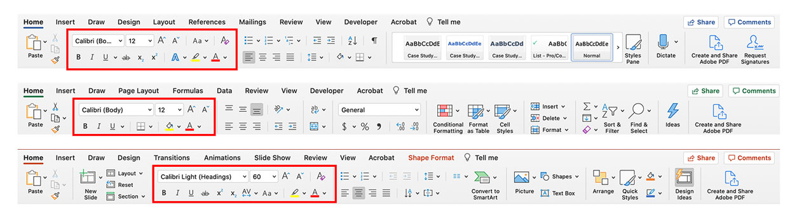
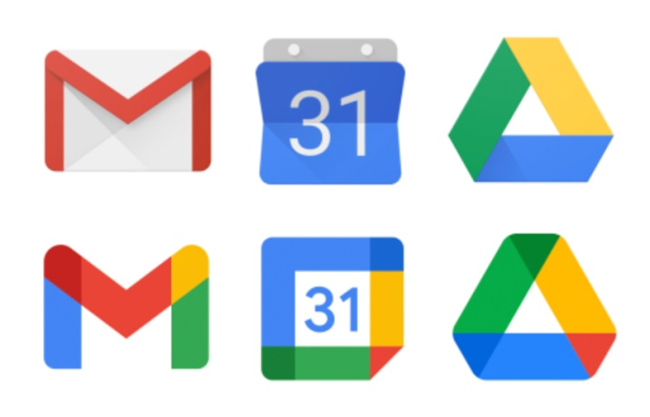
Consistency and standard
Internal consistency relates to consistency within a product or a family of products, either within a single application or across a family or suite of applications.

Slide 13
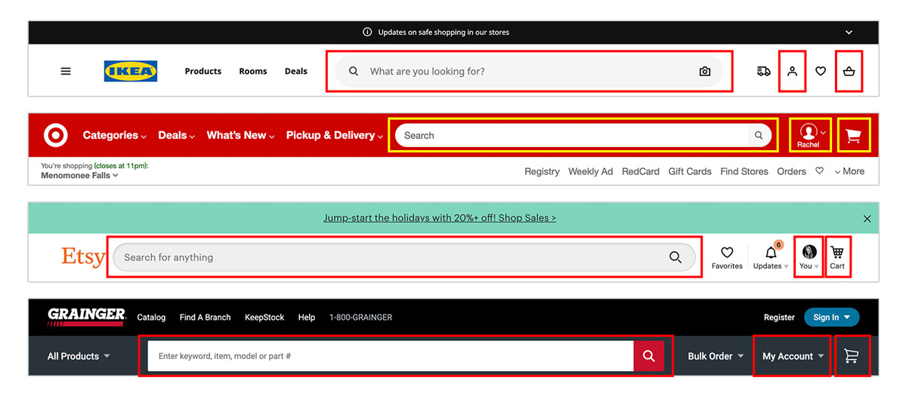
Consistency and standard
External consistency refers to established conventions in an industry or on the web at large, beyond one application or family of applications.

Slide 14
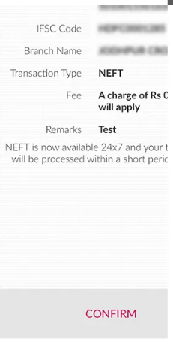
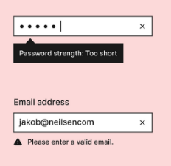
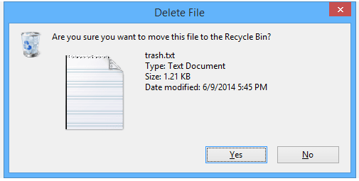
Error prevention
Minimize the likelihood of making mistakes
Good error messages are important, but the best designs carefully prevent problems from occurring in the first place.
Either eliminate error-prone conditions, or check for them and present users with a confirmation option before they commit to the action.

Slide 15
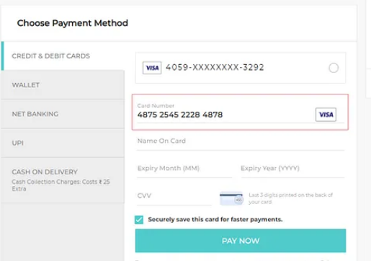
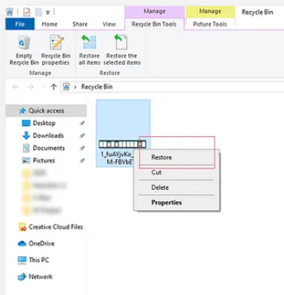
Error prevention
Prioritize your effort: Prevent high-cost errors first, then little frustrations.
Avoid slips by providing helpful constraints and good defaults.
Prevent mistakes by removing memory burdens, supporting undo, and warning your users.

Slide 16
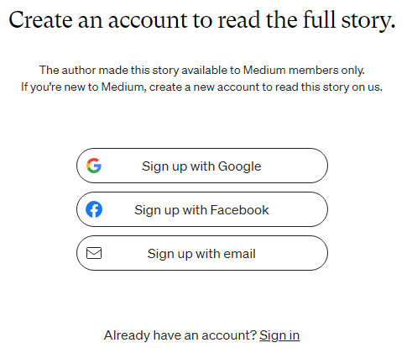
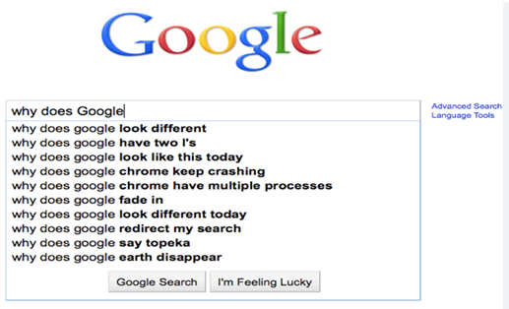
Recognition rather than recall
Minimize the user's memory load by making elements, actions, and options visible.
The user should not have to remember information from one part of the interface to another.
Information required to use the design (e.g. field labels or menu items) should be visible or easily retrievable when needed.

Slide 17
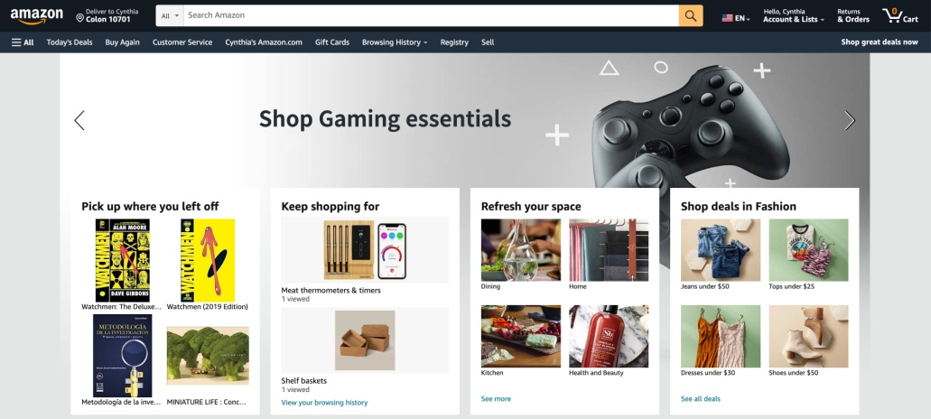
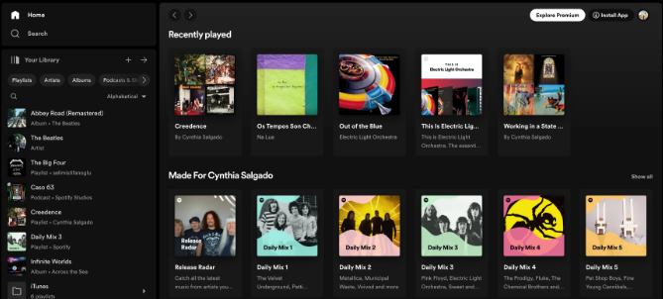

Recognition rather than recall
Let people recognize information in the interface, rather than forcing them to remember (“recall”) it.
Offer help in context, instead of giving users a long tutorial to memorize.
Reduce the information that users have to remember.

Slide 18
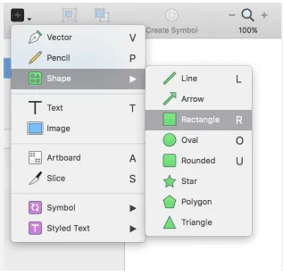
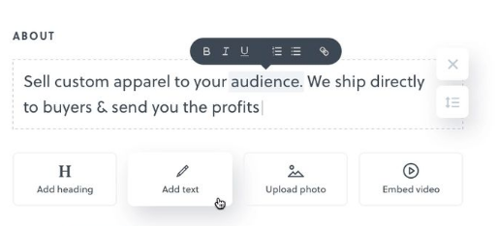
Flexibility and efficiency of use
Shortcuts — hidden from novice users — may speed up the interaction for the expert user so that the design can cater to both inexperienced and experienced users. Allow users to tailor frequent actions.
Flexible processes can be carried out in different ways, so that people can pick whichever method works for them.

Slide 19
Flexibility and efficiency of use
Provide accelerators like keyboard shortcuts and touch gestures.
Provide personalization by tailoring content and functionality for individual users.
Allow for customization, so users can make selections about how they want the product to work.

Slide 20
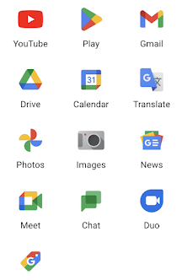
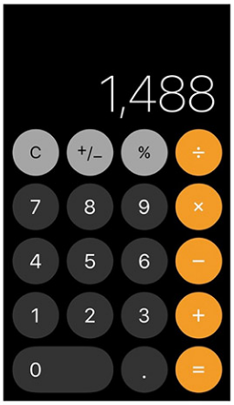
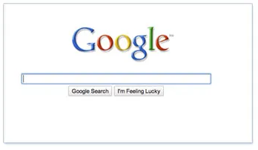
An aesthetic and minimalist design
Interfaces should not contain information that is irrelevant or rarely needed.
Every extra unit of information in an interface competes with the relevant units of information and diminishes their relative visibility.

Slide 21
An aesthetic and minimalist design
Keep the content and visual design of UI focused on the essentials.
Don't let unnecessary elements distract users from the information they really need.
Prioritize the content and features to support primary goals.

Slide 22
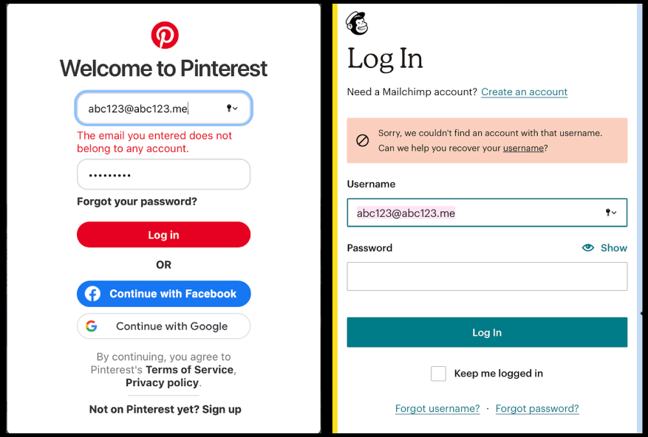
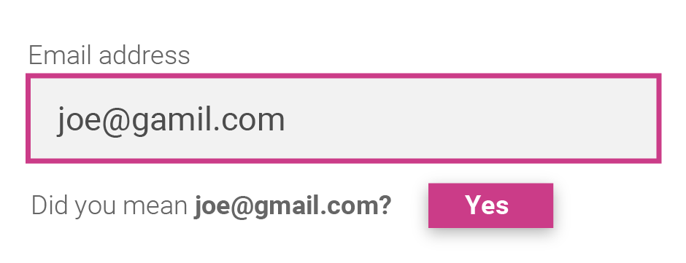
Help users recognize, diagnose, and recover from errors
Error messages should be expressed in plain language (no error codes), precisely indicate the problem, and constructively suggest a solution.
These error messages should also be presented with visual treatments that will help users notice and recognize them.

Slide 23
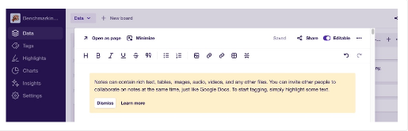
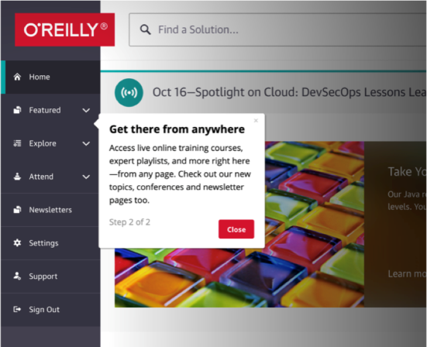
Help and documentation
It’s best if the system doesn’t need any additional explanation. However, it may be necessary to provide documentation to help users understand how to complete their tasks.
Help and documentation content should be easy to search and focused on the user's task. Keep it concise, and list concrete steps that need to be carried out.

